Slide 1
Lecture 20
Finite State Machines
CSCI – 1900 Mathematics for Computer Science
Fall 2014
Bill Pine

Slide 2
Lecture Introduction
Reading
  Rosen Section 13.2
Machines
Finite state machines (FSM)
Examples of FSM
  Model of a newspaper vending box
  Model of regular expressions

Slide 3
Machine
A machine is a system that
  Accepts input
  Has memory to store information on previous inputs
  Can (optionally) produce output
Machine state
  The complete internal condition of the machine and all of the memory
The current state and the next input determines the next state to be occupied

Slide 4
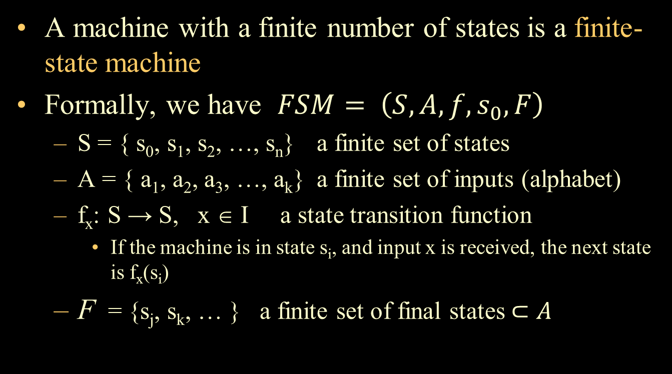
Finite-State Machine
A machine with a finite number of states is a finite-state machine
Formally, we have $FSM= \left(S, A, f, s_{0}, F\right)$
  S = { s₀, s₁, s₂, …, s_{n}} a finite set of states
  A = { a₁, a₂, a₃, …, a_{k}} a finite set of inputs (alphabet)
  f_{x}: S → S, x ∈ I a state transition function
    If the machine is in state s_{i}, and input x is received, the next state is f_{x}(s_{i})
  F = {s_{j}, s_{k}, … } a finite set of final states $⊂A$

Slide 5
Finite-State Machine (cont)
In simple language, a finite-state machine is defined by
  A finite set of states,
  A finite set of inputs,
  An initial state,
  A function defining the transitions from one state to another, for a specified input, and
  A finite set of final or acceptance state

Slide 6
Finite-State Machine (cont)
State machine diagrams
  Are labeled digraphs
States are represented by circles
  The state name appears within the circle
  The final state is indicated by two concentric circles
The transitions are represented by arcs
  The arcs are labeled with the input that initiates the transition

Slide 7
Finite State Machine - Example
Consider a simple newspaper vending box
  Paper price - 30 cents
  Accepts nickels, dimes, and quarters
  No change given
We want to create a finite-state machine model of the vending box

Slide 8
FSM – Example (cont)
Define state names as the value of coins that need to be deposited to purchase a paper
S = {30, 25, 20, 15, 10, 5, 0}
  Initial state = 30
  Final state = 0
A = {nickel, dime, quarter}
f - transition function
  As defined by the table
f
 | n | d | q
30 | 25 | 20 | 5
25 | 20 | 15 | 0
20 | 15 | 10 | 0
15 | 10 | 5 | 0
10 | 5 | 0 | 0
5 | 0 | 0 | 0
0 | 0 | 0 | 0

Slide 9
Diagraph Notation
State
Initial state
Final (or acceptance) state
q
Transition (on input q)

Slide 10
Newspaper Vending Box Digraph
d
d
d
d
d
n
n
n
n
n
n
30
25
20
15
10
5
0
q
0
q
q
q
q
q
q

Slide 11
FSMs and Regular Expressions
We can design a FSM that can be used to determine if a string belongs to the regular set that corresponds to a specified regular expression

Slide 12
Regular Expression Examples
Given the alphabet A = {a, b, c}
Example
  a*b
a
a*
b
a*b

Slide 13
Examples (cont)
  (ab ∨ ba)c*
a
b
c
b
a

Slide 14
Examples (cont)
Does the following machine correspond to
  (a ∨ b)*c*
a
a
c
a
c
b
a
c
b
c
b
b

Slide 15
Key Concepts Summary
Machines
Finite state machines (FSM)
Examples of FSM
  Model of a newspaper vending box
  Model of regular expressions
Reading for next time
  No further readings

